Slide 1

Cloud-based Open Access Tools for Digital Humanities
ADHC Lunch & Learn | Wednesdays @12PM

Slide 2
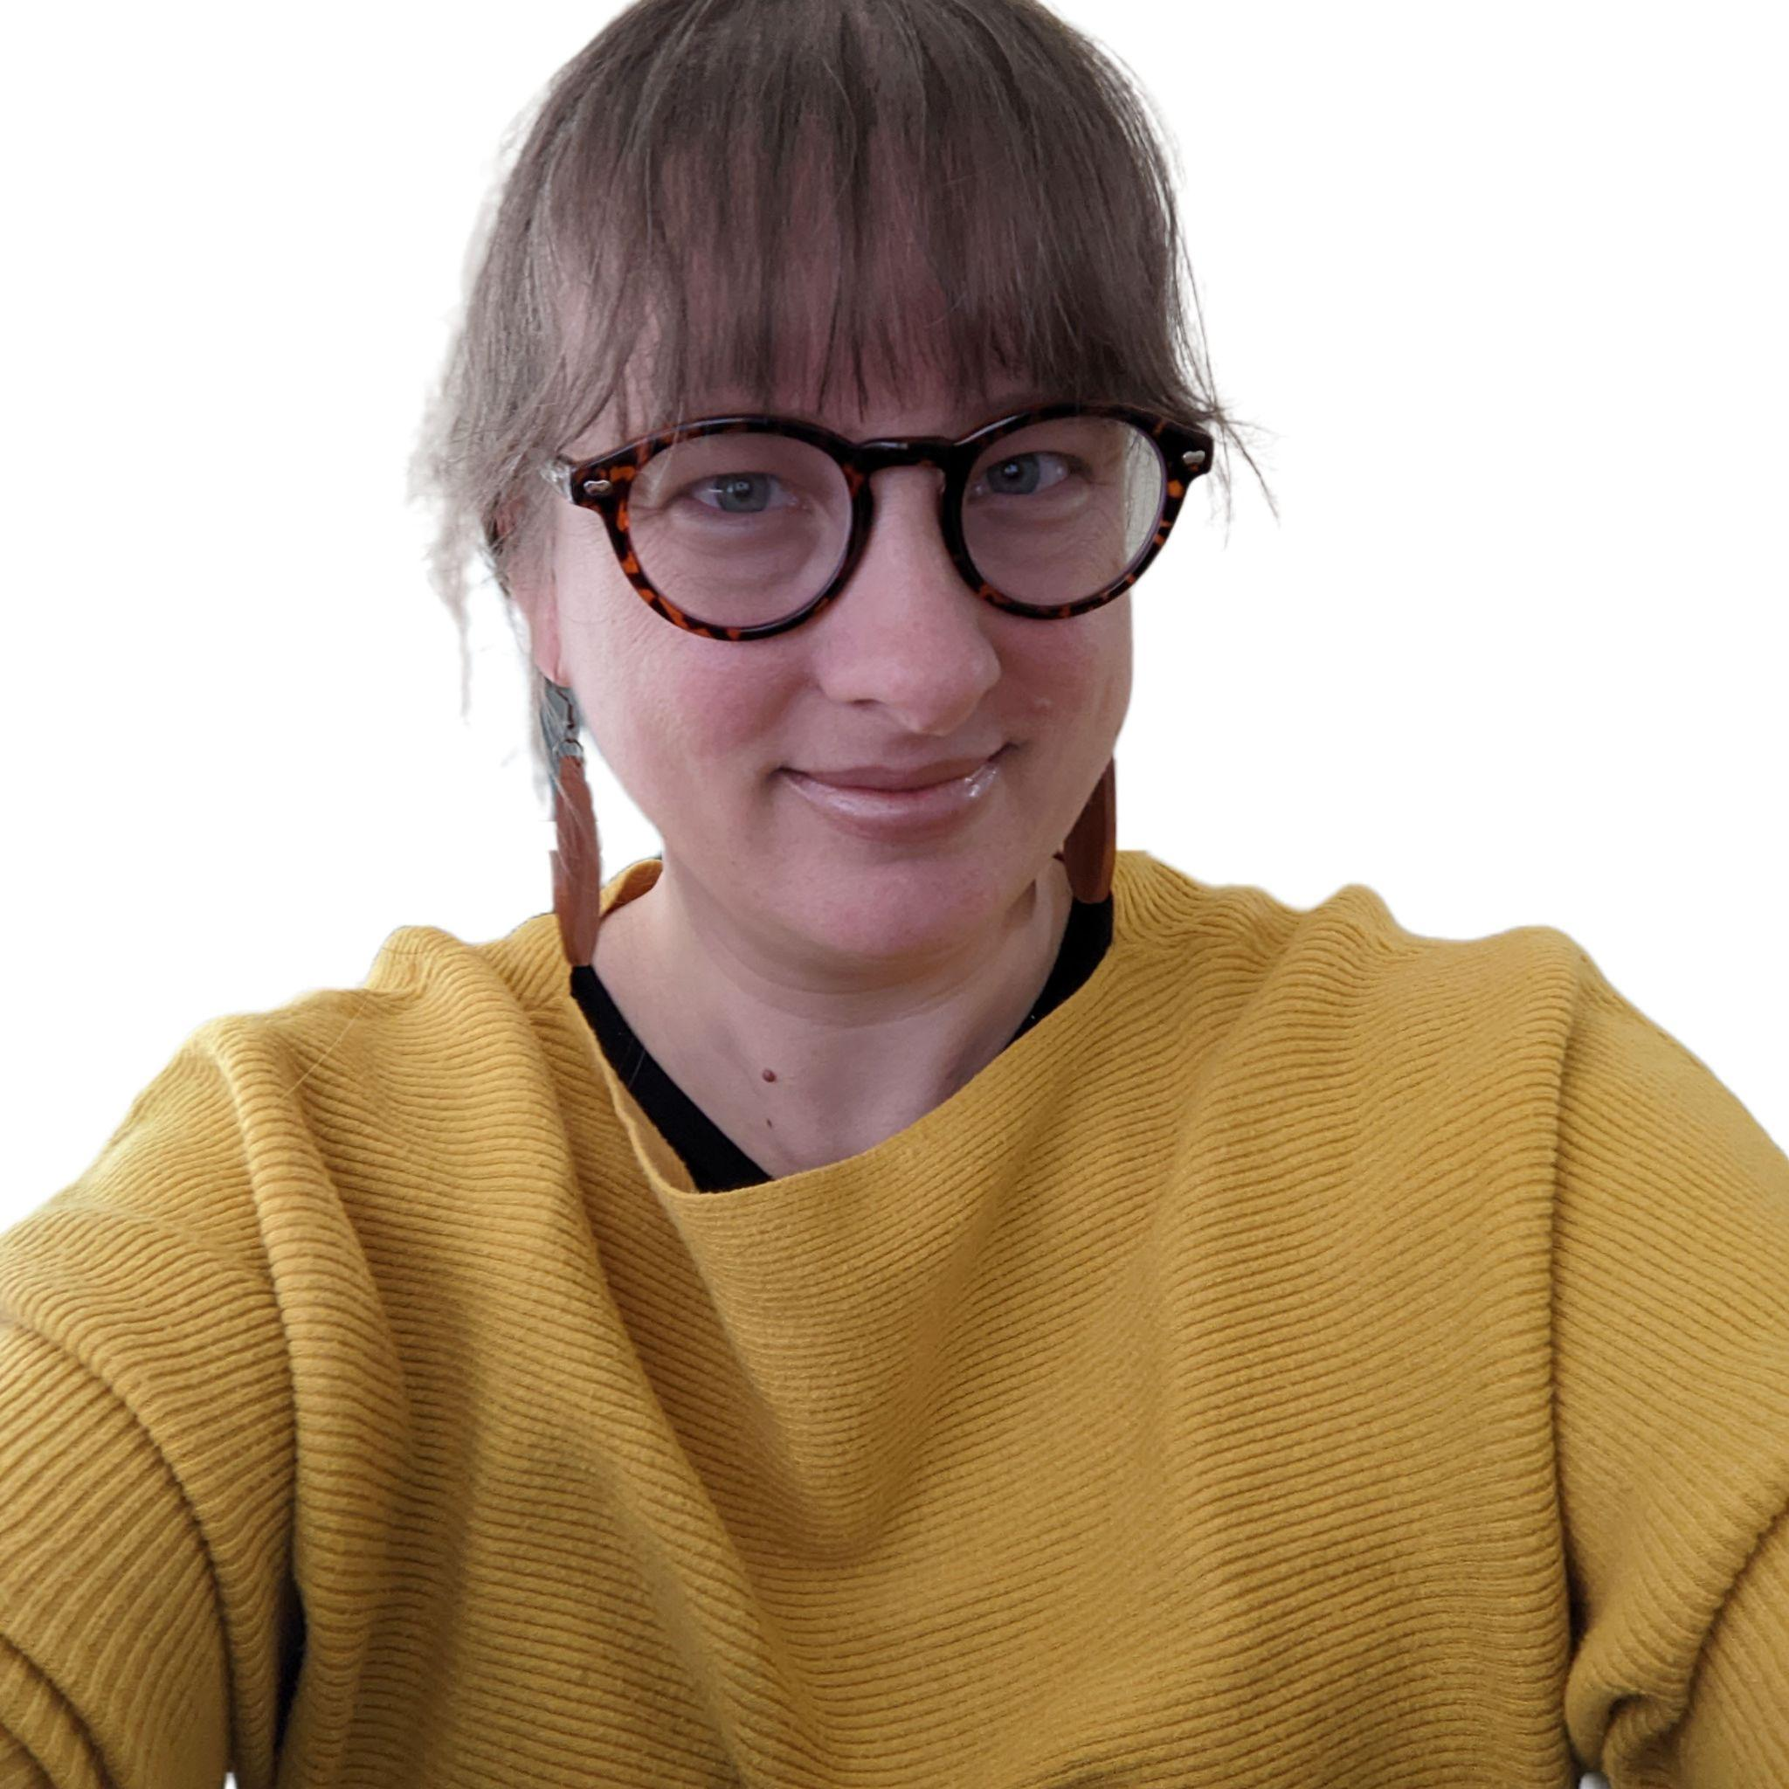
Workshop Facilitator:
Sara Whitver is the Digital Humanities Librarian. She runs the Alabama Digital Humanities Center and is the library liaison for the Department of English. You can reach her at: smwhitver@ua.edu

Slide 3

adhc.lib.ua.edu

Slide 4
Overview
Today, I am going to spend some time introducing you to a number of applications that you can immediately start using to build digital projects. I have chosen all of these applications because they meet the following criteria:
Lightweight
Open Access
Cloud-Based
We aren’t planning to do any hands-on playtime today, but I am going to provide follow-up information for you to use.

Slide 5
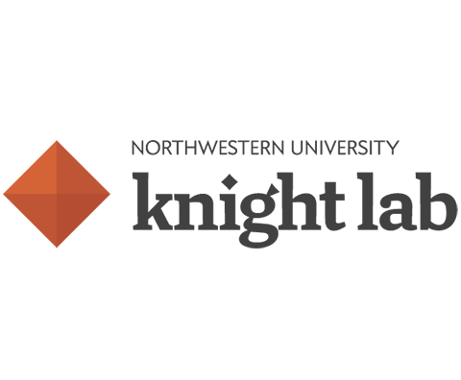


Today’s Tools:
TimelineJS StoryMapsJS SceneVR | Omeka.net Zotero | Voyant Text Analysis Tool

Slide 6
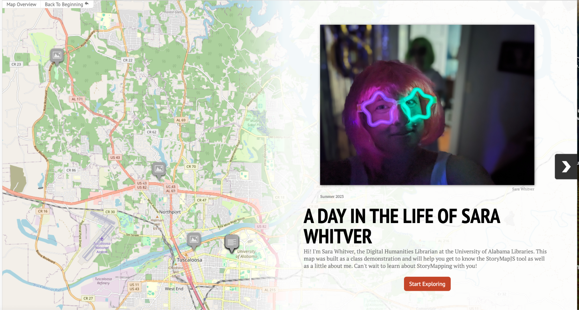
StoryMapsJS

Slide 7
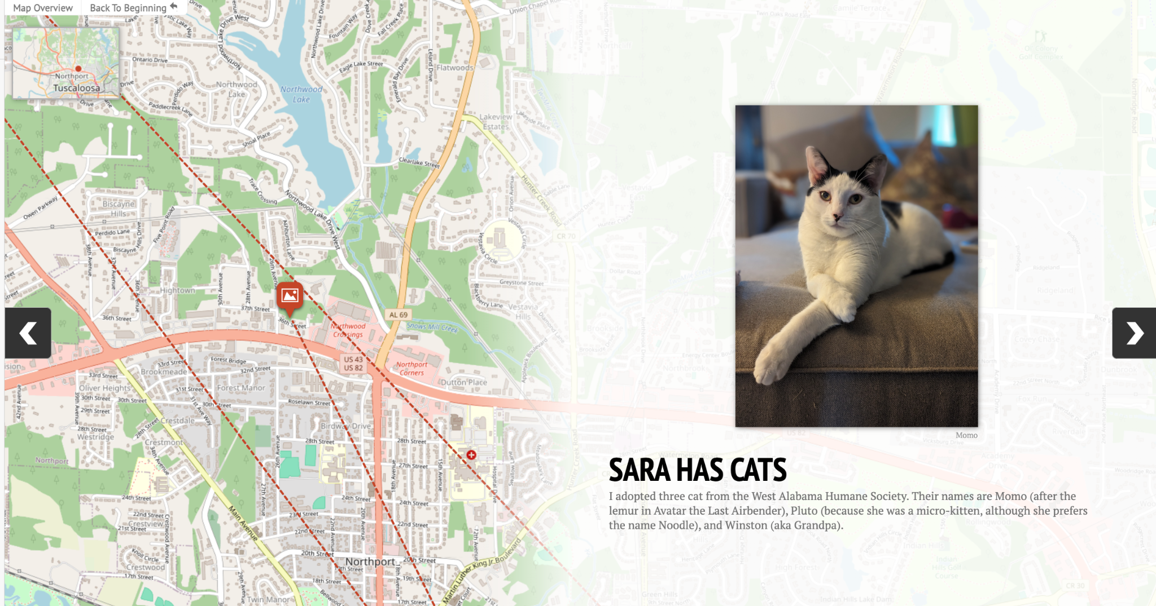
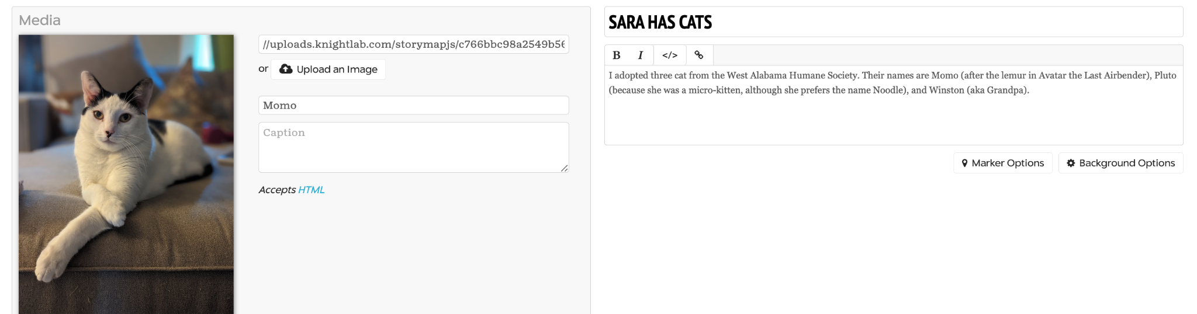
StoryMapsJS (Knightlab)

Slide 8
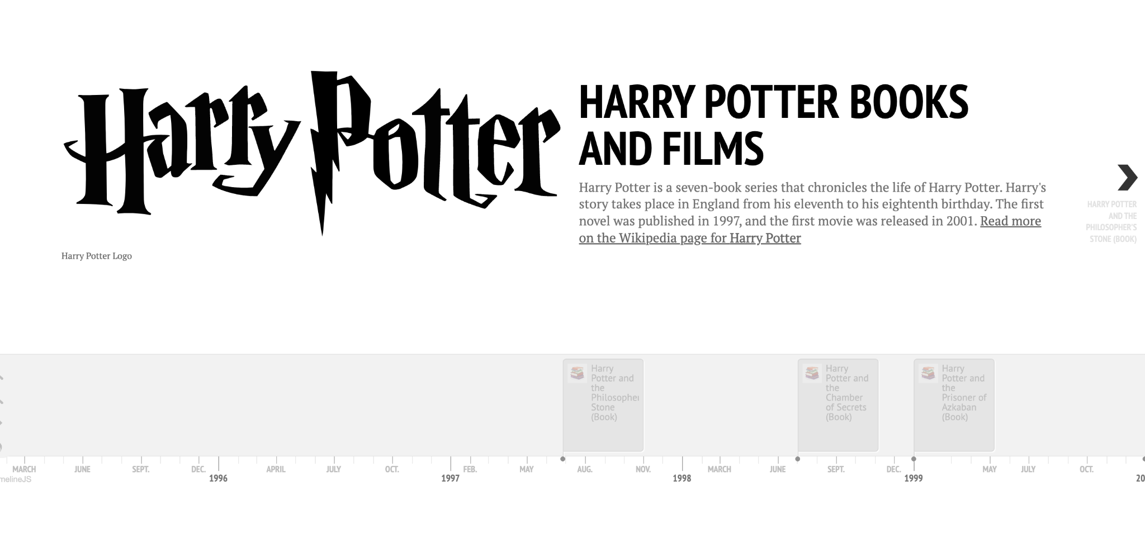
TimelineJS

Slide 9
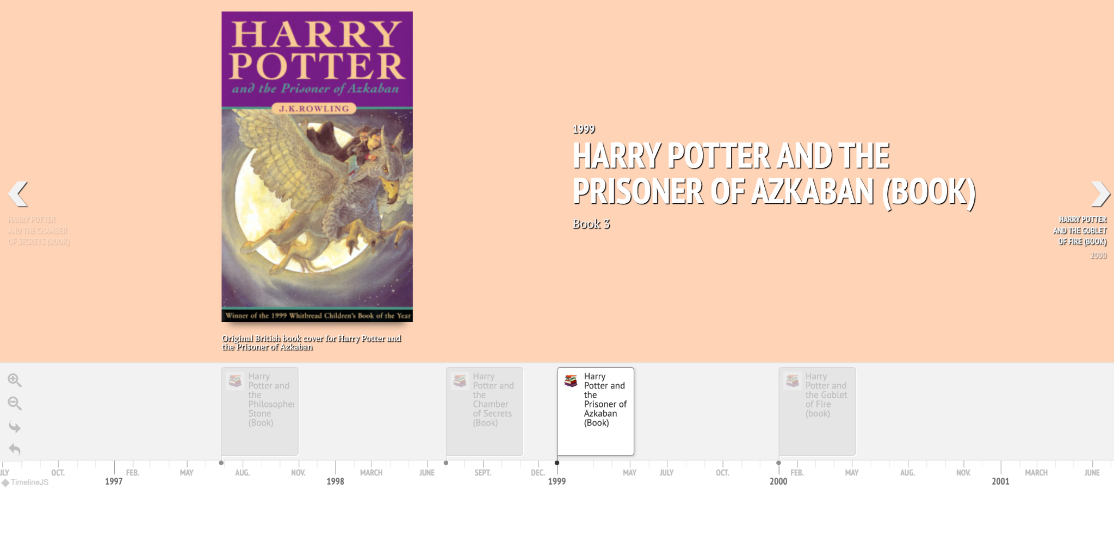
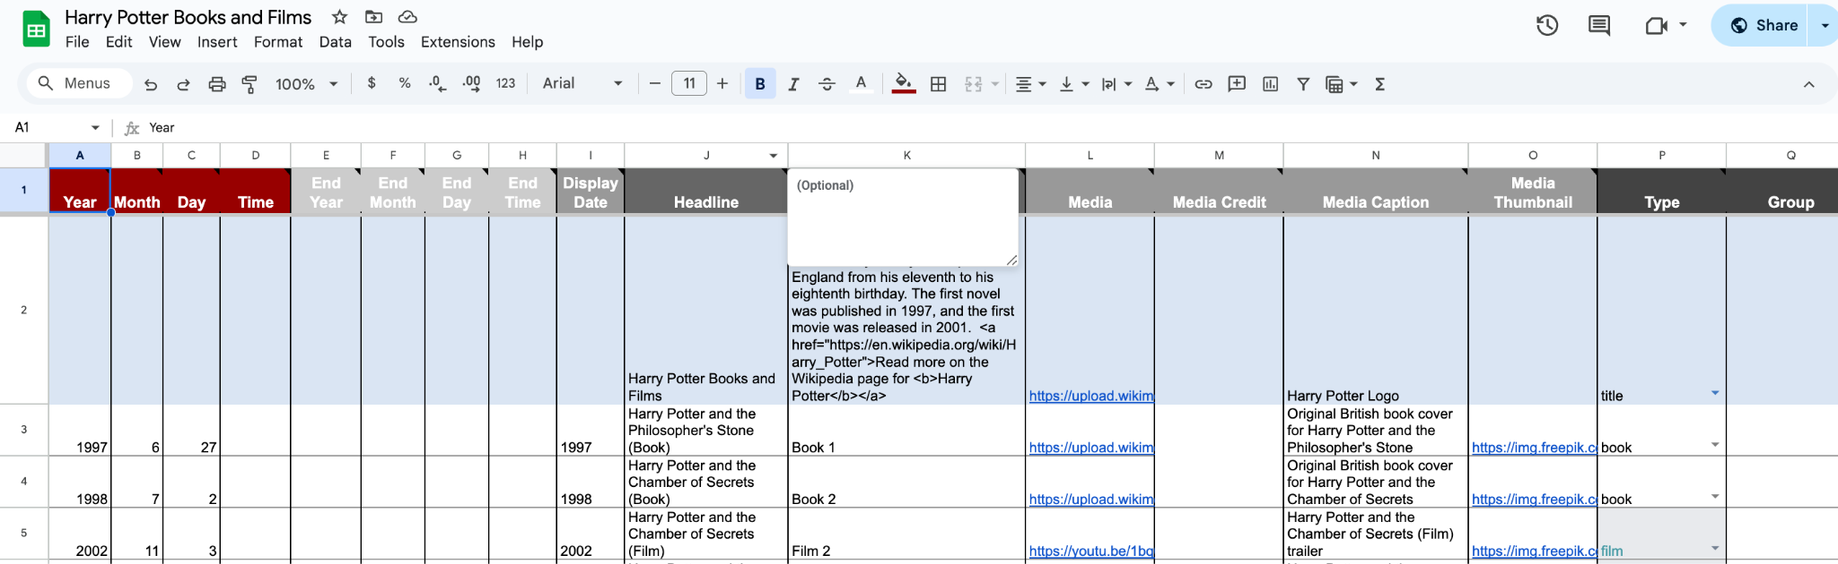
TimelineJS (Knightlab)

Slide 10
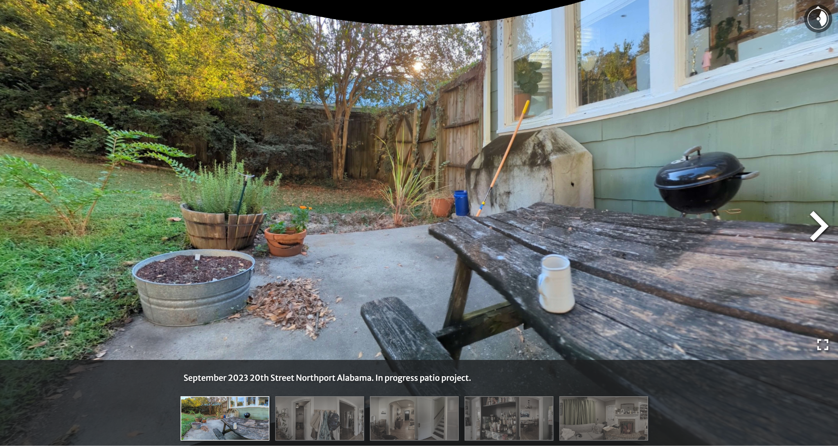
SceneVR

Slide 11
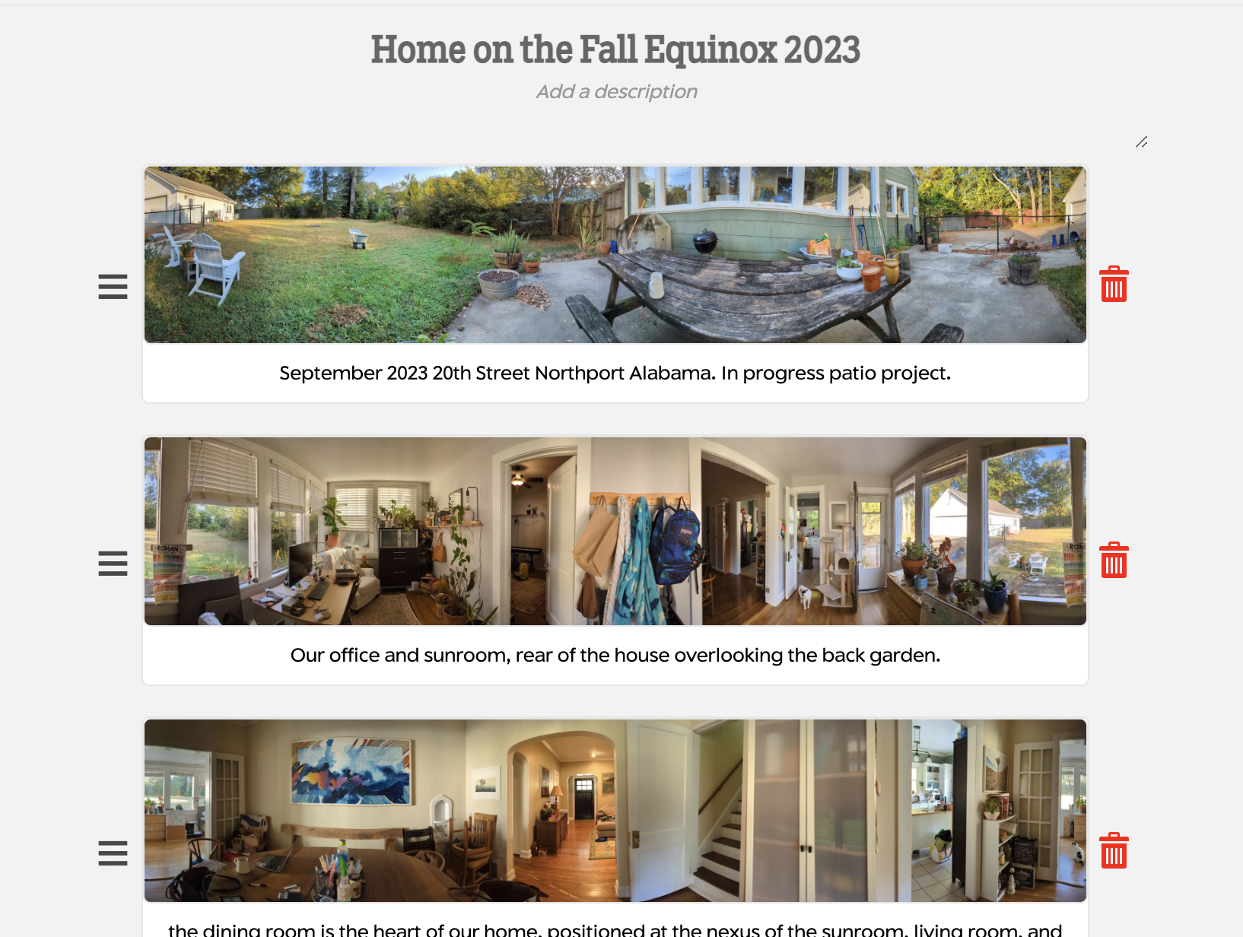
TimelineJS (Knightlab)

Slide 12
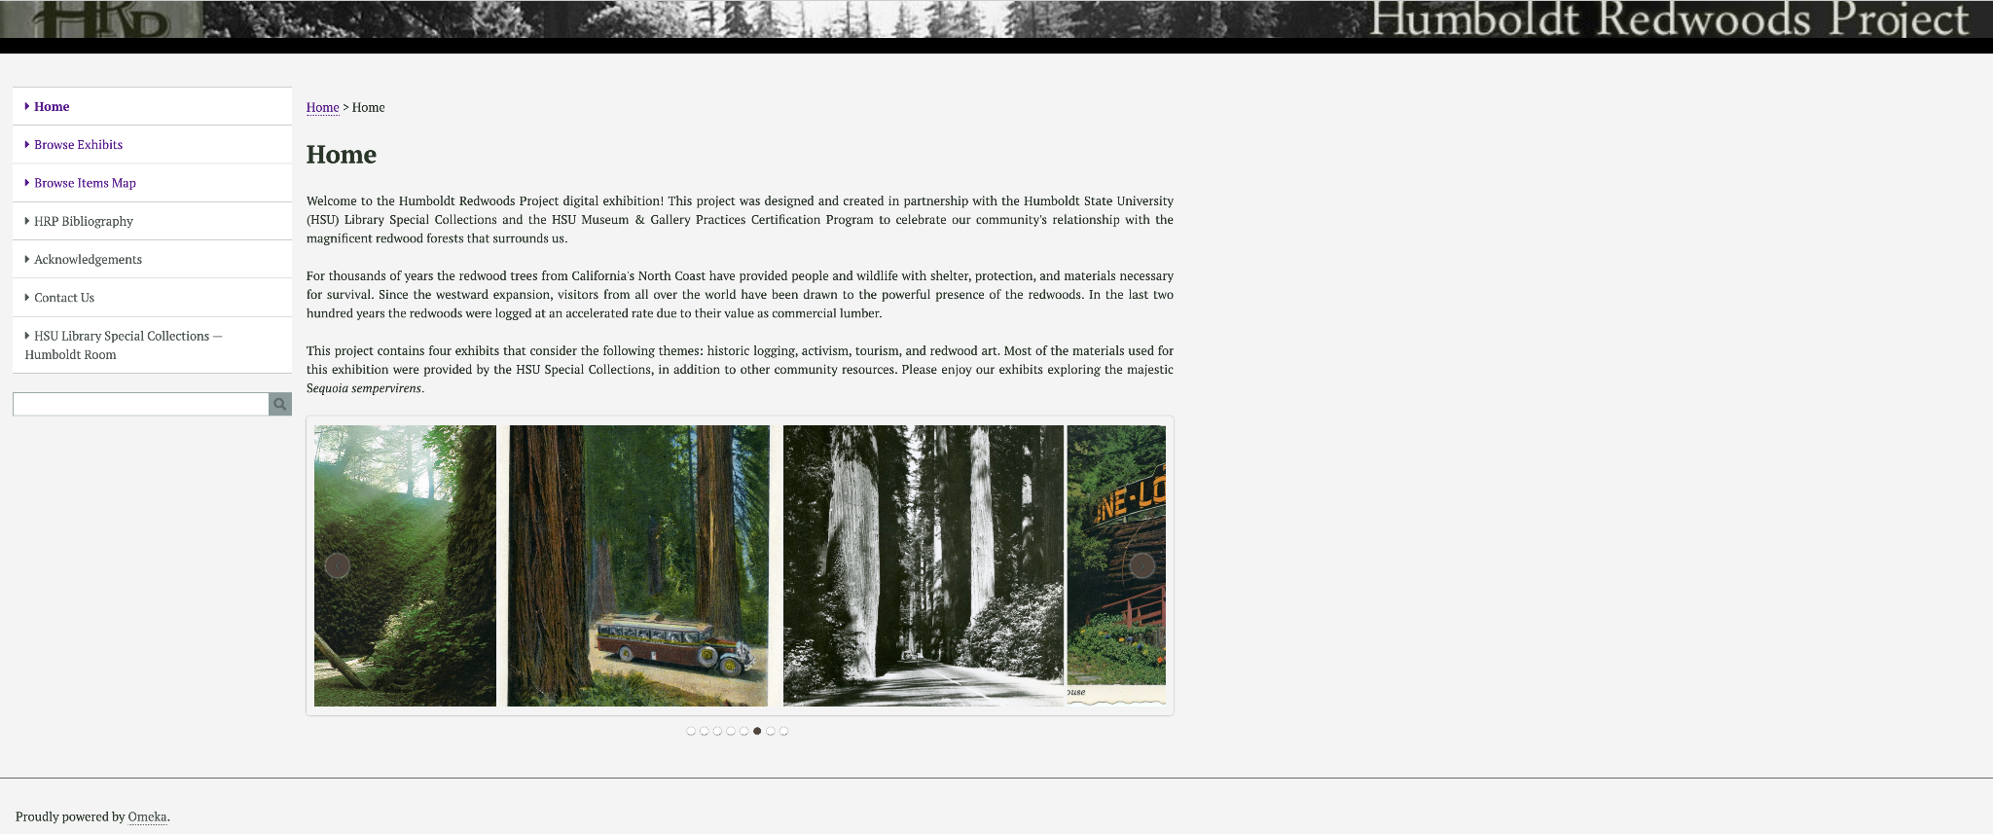
Omeka.net

Slide 13
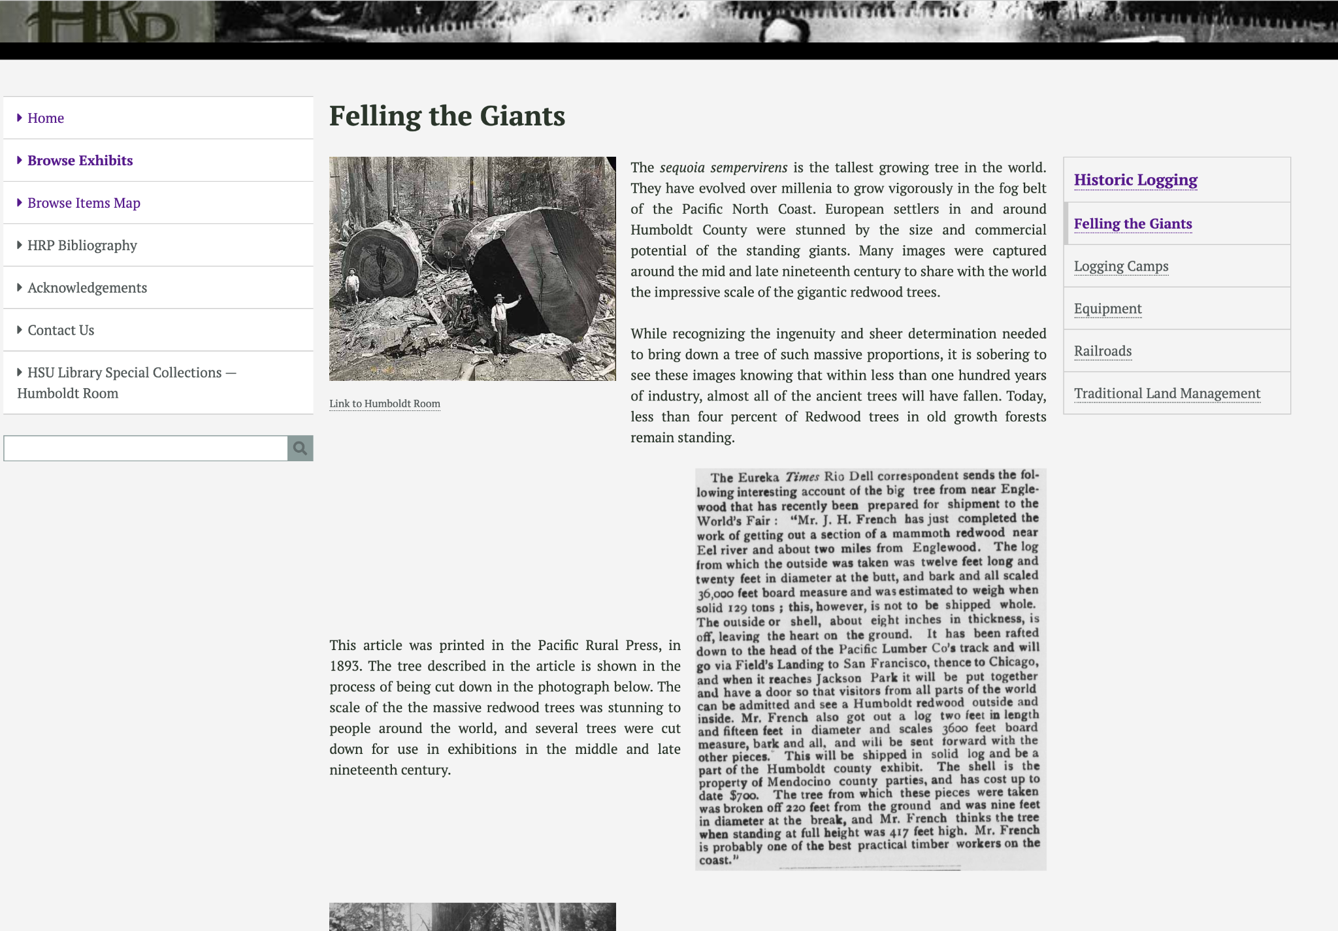
Omeka.net (Digital Scholar)

Slide 14
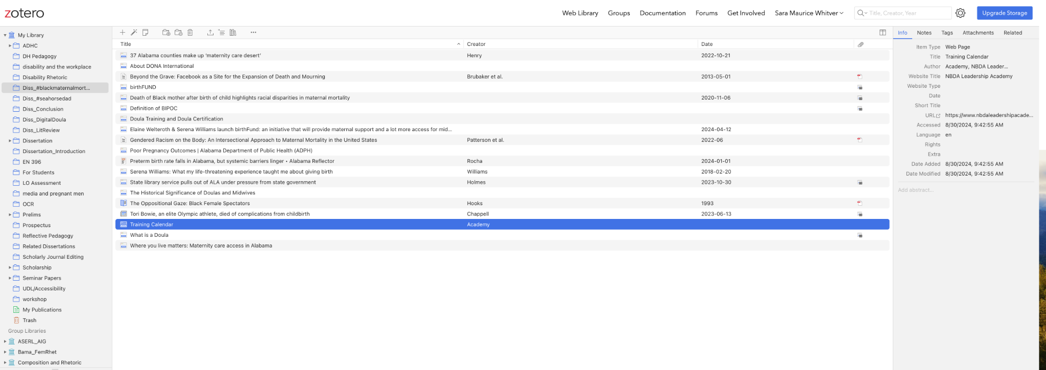
Zotero

Slide 15
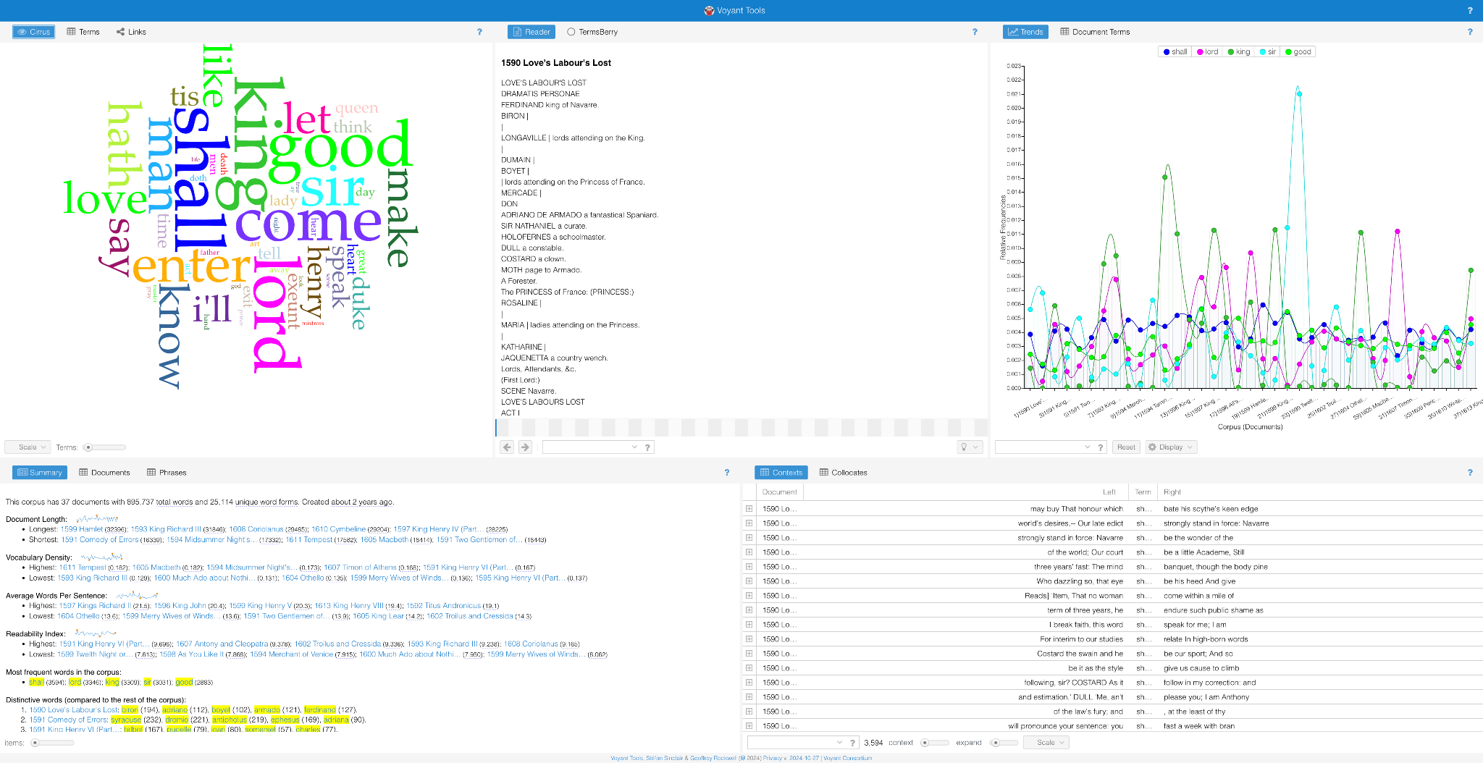

Slide 16
Links and Resources
Knight lab
Omeka.net
Zotero
Voyant
Digital Humanities @University Libraries

